Slide 1
Waze Part III : More about Waze
KHEDHER Abdessalem, MILAVET Maxime, BERTI Charles

Slide 2
1:why such application in such time?
Indirect reasons behind this success

Slide 3
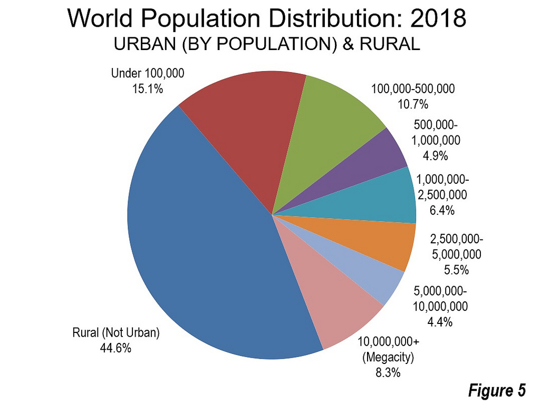
Growth of urban population
Cars and traffic problem mainly exists in urban areas

Slide 4
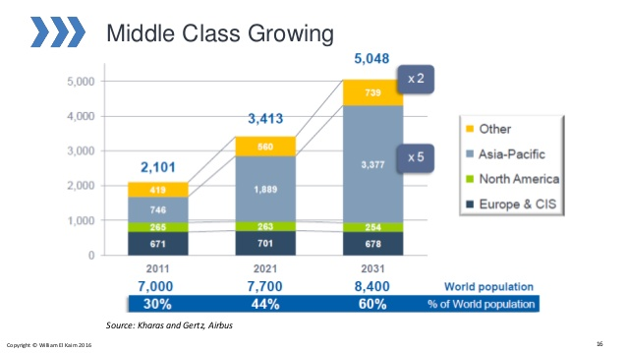
this class is the principal user of such type of apps because they use cars every day to go to work or school and have many time constraints

Slide 5
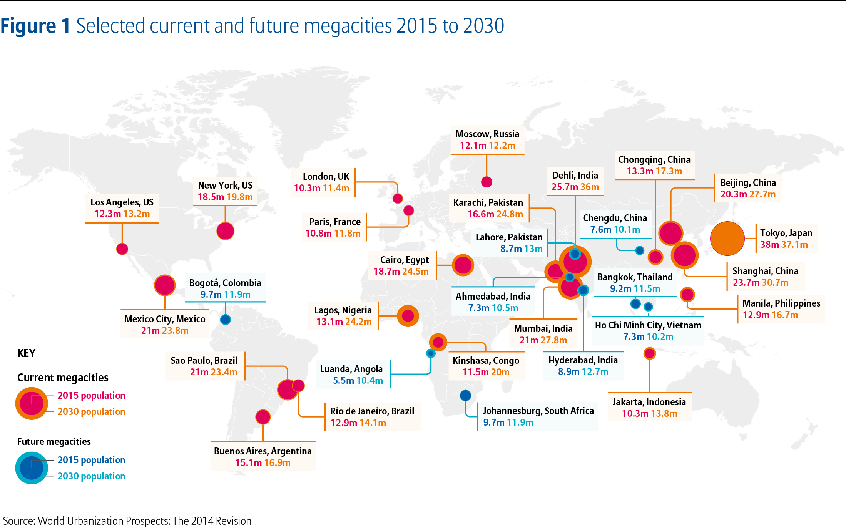
Rise of Megacities

Slide 6
2:Waze as a part of a big revolution
Mobility as a Service (MaaS)

Slide 7
Mobility as a Service (MaaS)
“MaaS is provision of transport via a real-time personalized service model that integrates all types of mobility choices and presents them to the customer in a completely integrated manner to get them from A to B as easily as possible.” • MaaS is a new concept in the transport sector; it provides a new way of thinking in terms of how the delivery and consumption of transport (or mobility) is managed:
• Integrated and seamless mobility services offered to a client by a public or a private mobility aggregators.
• MaaS is based on disruptive digital business services and models.
• MaaS is generally based on subscription business model, but could accept microtransaction

Slide 8
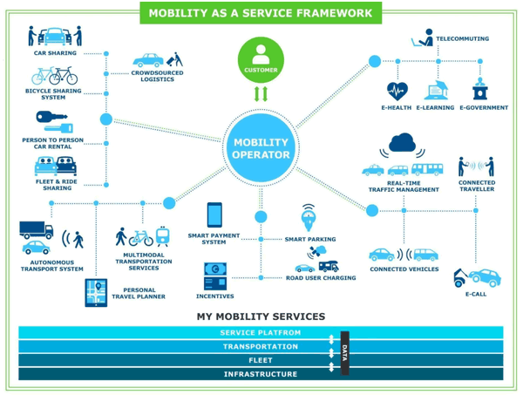

Slide 9
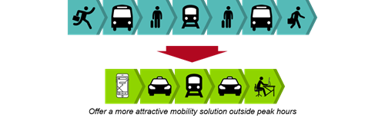

Slide 10
Sources
SlideShare: https://fr.slideshare.net/welkaim/mobility-as-a-service-maas?from_action=save
PTOS, Are you ready for MaaS?:
https://blog.ul-ts.com/posts/ptos-are-you-ready-for-maas/

